Slide 1
Modernizing Cohesity Customer Analytics on Microsoft Fabric

Slide 2
Requirements & Assumptions
Environment
Requirements
Create Fabric OneLake Shortcut to S3-compatible endpoint
1
Sync on-prem AD users to Microsoft Entra Id on Azure
2
Apply & preserve ACL permission model for SMB files ingested in OneLake
3
NAS file system exposing SMB and/or NFS shares
A curated set of SMB data is exposed via an S3-compatible endpoint (assuming this is provided by Cohesity)
Unstructured files (PDFs, Word, txt)
Permissions file with existing permissions of Department owners on the file systems
Metadata of Classifications/Tags
Target Implementation
Phase 1: SMB files & ACL implementation
Phase 2: Data Catalog & Purview integration
Notes:
Customers have NAS file systems which have SMB or NFS shares mounted into VMs or Physical Machines.
These NAS system have unstructured data in form on PDFs, Word, TXT and other formats.
The NAS systems have insights that can be unlocked using Cohesity’s metadata extraction processes.
Cohesity aims to provide these insights to their customers by integrating with Microsoft OneLake and Purview by leveraging data analytics capabilities in Microsoft Fabric and data governance capabilities in Microsoft Purview.
For the current Phase 1, SMB files are considered.
SMB shares are integrated with On-premises Active Directory and will have Access Control Lists(ACL) on folders and files.
These SMB files and permissions will need to be replicated on Fabric OneLake.
In the end state, the users can derive insights and access the files according to their roles and permissions.
This deck focused on NAS integration with Fabric OneLake followed up with Purview Integration.

Slide 3










Loading On-Prem NAS on Fabric OneLake
On-Prem Services
1
2
Microsoft Entra ID
3
Create Identities in Entra
Connect Sync
Entra Users
Fabric Tenant
AD Domain Controller
Workspace A
Zero ETL In-place Access
OneLake ShortCut
Lakehouse
S3-Compatible Endpoint
Azure Network Gateway
OneLake Security
ExpressRoute/Internet Connectivity
Prod VNet
On-prem Network Gateway
AD Domain Controller syncs on-prem identities to Microsoft Entra via Entra Connect Sync.
Sync process creates matching identities in Entra for users and groups.
Entra users and groups are used by Fabric and OneLake for authentication and authorization.
Access control is aligned between on-prem and cloud resources.
2
AD Domain Controller hosts on-prem user & groups
SMB files shares hold source files
Fabric On-prem Gateway provides secure connectivity to on-prem data
On-prem Network Gateway connects the corporate network on to Azure
1
3
Leverage gateway to ingest files into Lakehouse
Apply OneLake security for files ingested

Slide 4
ETL To Fabric OneLake
Networking & Security
Data Ingestion
OneLake Security & Governance
On-prem Network Gateway establishes connectivity to Azure via ExpressRoute or secure Internet VPN.
Azure Network Gateway terminates the connection inside an Azure Virtual Network.
Hybrid link is used by the Fabric On-prem Gateway to securely expose S3 Compatible Endpoint to Fabric services using OneLake Shortcuts.
All data traffic between on-prem and Azure is encrypted and controlled.
Microsoft Fabric is deployed in Azure with OneLake as the unified data lake.
Fabric Short cuts connects to the S3-Compatible Endpoint the On-prem Gateway to make the files available for Fabric Services.
With shortcuts, files stay in place and can be queried using Fabric services like Fabric Spark Notebooks. (There could be read latency depending on the network bandwidth and IOPs limitations on the S3-compatible endpoints)
Extend identities and network securely from on-prem to Azure via Microsoft Entra and hybrid connectivity.
OneLake security and lakehouse permissions enforce data-level governance and access policies.
Centralize data in a governed Fabric Lakehouse for analytics, reporting, and downstream workloads.
Modernize analytics without disrupting existing on-prem identity, security, and connectivity models.

Slide 5


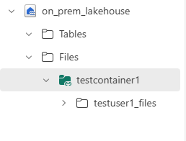
Loading On-Prem NAS on Fabric OneLake
On-Prem Services
1
2
Microsoft Entra ID
Fabric Tenant
Create Identities in Entra
OneLake Security
4
AD Domain Controller
Connect Sync
Entra Users
Lakehouse
SQL Endpoint
Business analysts
Permissions File
3
Custom Application Applying Source ACLs
Read ACLs
Spark
notebooks
Data Scientists
Power BI
Data Access Role Custom Application/Container
Business user
Permissions files contains NTFS/ACL-based permissions on the source files
Custom application reads ACLs from the Permissoins file and configures OneLake Data Access roles. Leverages Fabric Rest APIs.
Folder level Permissions
1
3
2
On-prem Sync for users & groups into Entra Id
4
User authenticate with Entra Id and roles are applied as folder-level permissions within the Lakehouse 'Files'

Slide 6
One Lake Security and Permission Model
From SMB File Shares ACLs
To OneLake Security ACLs
SMB file shares store the original data and enforce NTFS/ACL-based permissions.
A custom Data Access Role application reads ACLs from the Permissions File and configures OneLake Data Access roles.
Data access roles are pushed via Fabric OneLake Security REST APIs.
Roles are bound to Entra users and groups that were synchronized from on-prem AD.
Within Microsoft Fabric, OneLake Security manages data access roles for lakehouse items.
Roles are applied as folder-level permissions within the lakehouse 'Files' area.
Users authenticate with Microsoft Entra identities when accessing Fabric lakehouses.
OneLake evaluates the user’s data access roles for each folder and file request.
Only users with matching roles derived from on-prem ACLs can read or write the mapped folders.
Delivers end-to-end governance that mirrors on-prem permissions while enabling cloud analytics.

Slide 7
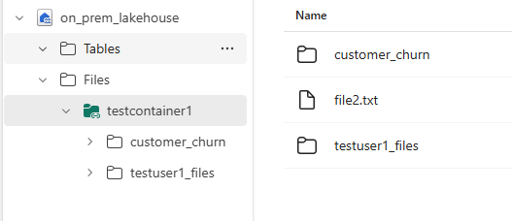
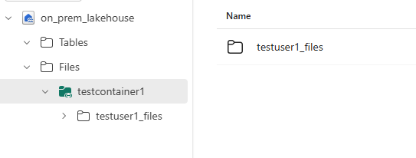
OneLake Security Example
Department Data Owner can read all files in Fabric Lakehouse(OneLake) Container
Data Scientist sees only the files he/she has access to according to on-prem permissions

Slide 8





Data Governance with Purview
Purview Tenant
AD Domain Controller
Unified Catalog
Owns Data
Data Owner
SMB File Shares
Curated Metadata
Scan and Classify Sensitive Documents
Attests Data
Data SMEs
Discovers Trusted Data
Publish Metadata and Classifications to Purview using Rest APIs
Business user
Custom Docker Container for Classifications
Data Discovery
Data Classification
Data Quality etc
Microsoft Cognitive Containers

Slide 9
Fabric OneLake usage scenarios
How would customers be onboarded on to Microsoft Fabric? For e.g would customers bring their Fabric Tenant? Cohesity’s Fabric Tenant?
How would customers use the onboard files and metadata?
Would there be post processing, analytics, visualization etc?
What other use cases are you thinking about for the data in Onelake?

